Slide 1


CERAMIC
BILLING & STOCK MANAGEMENT SYSTEM
PRESENTED BY : KRISH PATEL

Slide 2
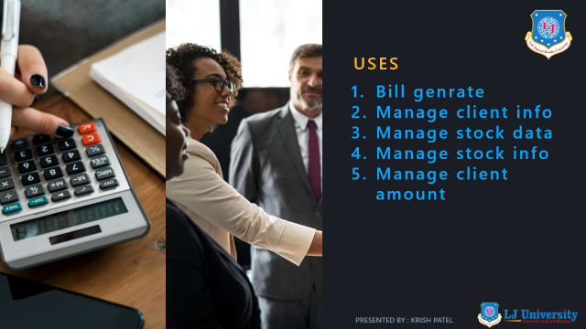
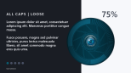
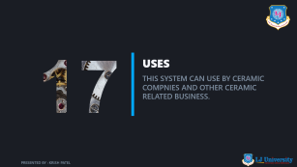


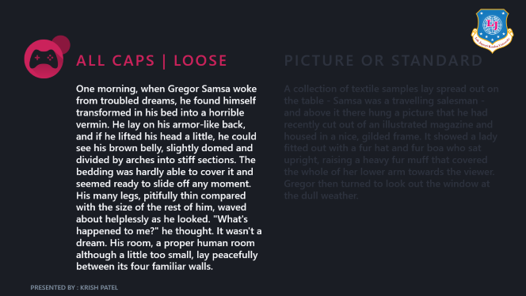


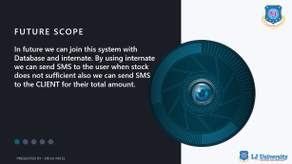



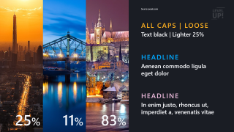
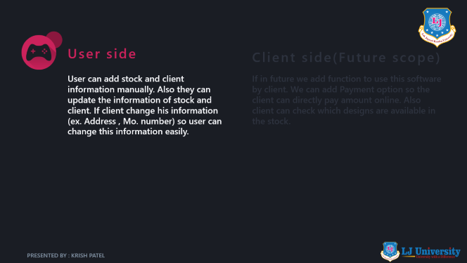

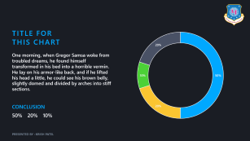
USES & FEATURES
JAVA | USES | FEATURES
introduction
PICTURE AND TEXT
GRAPHICS AND CHARTS
PRESENTED BY : KRISH PATEL

Slide 3

KRISH PATEL
ENROLLMENT NO : 22002170210075
ROLL NO : 257
CLASS : 5A

Slide 4

JAVA BASICS
ARRAYS OF OBJECT
IF-ELSE CONDITION
FOR LOOP
Etc.
PRESENTED BY : KRISH PATEL

Slide 5

USES
THIS SYSTEM CAN USE BY CERAMIC COMPNIES AND OTHER CERAMIC RELATED BUSINESS.
PRESENTED BY : KRISH PATEL

Slide 6


USES
Bill genrate
Manage client info
Manage stock data
Manage stock info
Manage client amount
PRESENTED BY : KRISH PATEL

Slide 7
MAIN USE
This system mainly use for genrate bill. When user enter the number of box which they need automatically the stock remove from total available stock.
PRESENTED BY : KRISH PATEL

Slide 8


23%
FUTURE SCOPE
In future we can join this system with Database and internate. By using internate we can send SMS to the user when stock does not sufficient also we can send SMS to the CLIENT for their total amount.
PRESENTED BY : KRISH PATEL

Slide 9





HEADLINE 5
HEADLINE 4
FEATURE 3
FEATURE 2
FEATURE 1
HEADLINE 3
HEADLINE 2
Bill Genrate
PRESENTED BY : KRISH PATEL

Slide 10
HEADLINE 5
FEATURE 3
FEATURE 2
FEATURE 1
HEADLINE 4
HEADLINE 3
HEADLINE 2
Client data
PRESENTED BY : KRISH PATEL

Slide 11
FEATURE 3
FEATURE 2
FEATURE 1
HEADLINE 5
HEADLINE 4
HEADLINE 3
HEADLINE 2
Stock data
PRESENTED BY : KRISH PATEL

Slide 12

User side
Client side(Future scope)
User can add stock and client information manually. Also they can update the information of stock and client. If client change his information (ex. Address , Mo. number) so user can change this information easily.
If in future we add function to use this software by client. We can add Payment option so the client can directly pay amount online. Also client can check which designs are available in the stock.
PRESENTED BY : KRISH PATEL

Slide 13
User side
Client side(Future scope)
User can add stock and client information manually. Also they can update the information of stock and client. If client change his information (ex. Address , Mo. number) so user can change this information easily.
If in future we add function to use this software by client. We can add Payment option so the client can directly pay amount online. Also client can check which designs are available in the stock.
PRESENTED BY : KRISH PATEL

Slide 14

THANK YOU
PRESENTED BY : KRISH PATEL

